Slide 1
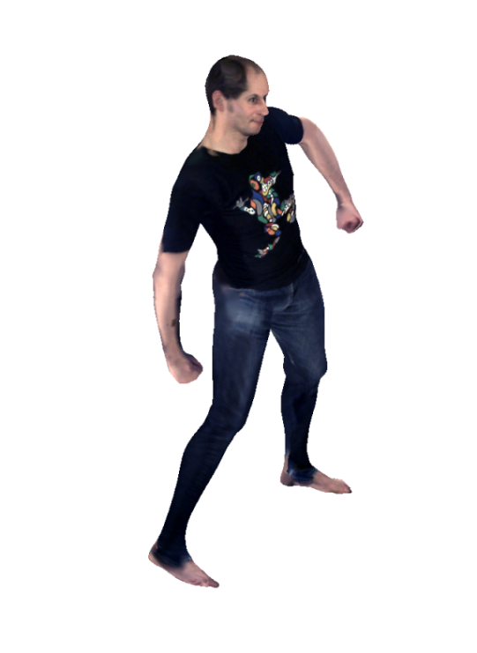
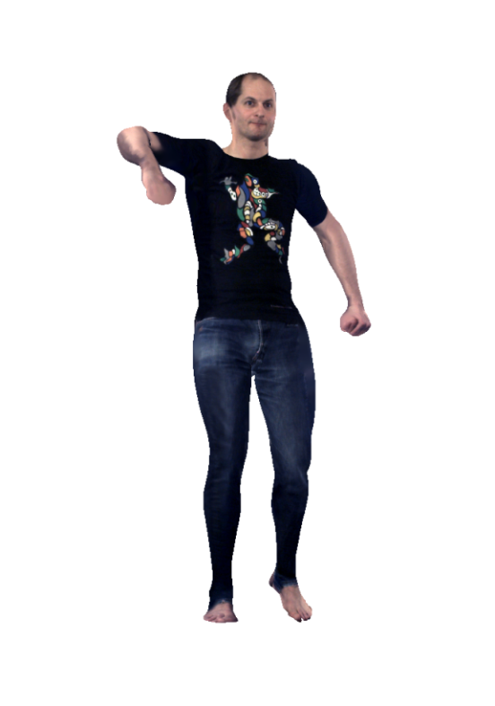
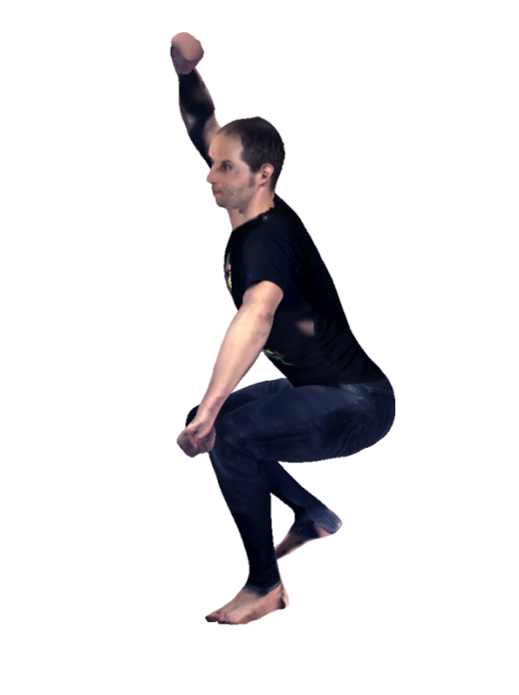
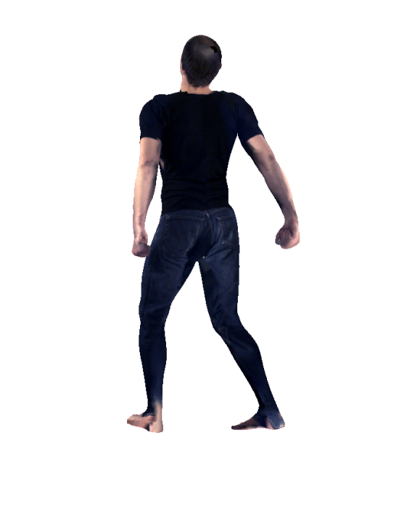
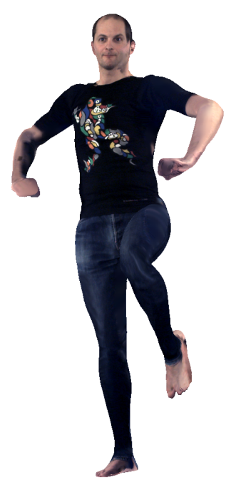
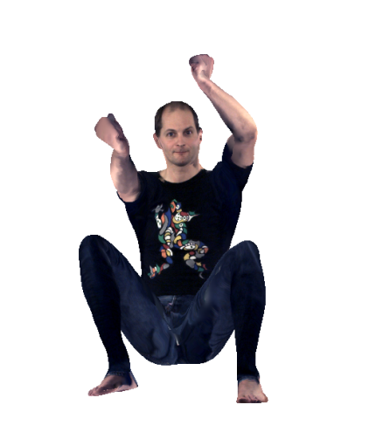
Articulated 3D Model Tracking with On-The-Fly Texturing
P. Fechteler, W. Paier, P. Eisert
IEEE ICIP 2014
29. October 2014

Slide 2
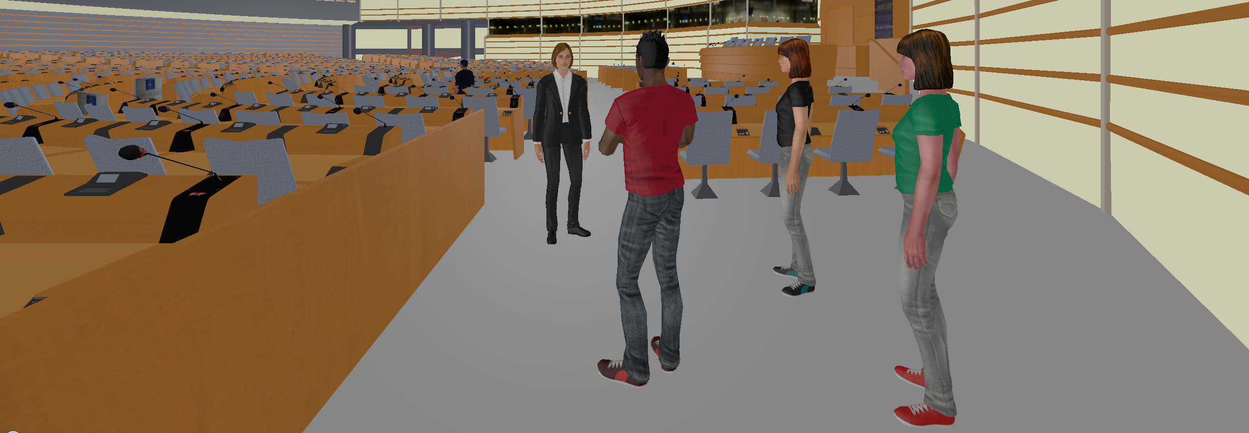
Motivation
Immersive 3D telecommunications

Slide 3
Motivation
Immersive 3D telecommunications – work in progress
Requirements
Light-weight parametrization for photo-realistic 3D human representation
Ability to animate to allow autonomous behaviour of avatars
Not here: on-the-fly capturing and extraction of control parameters

Slide 4
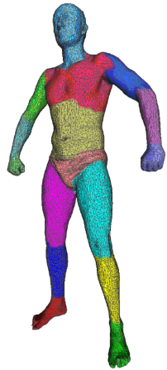
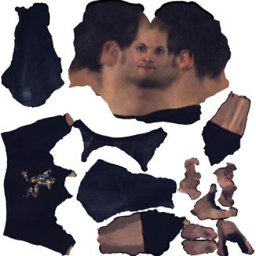
Our approach
Combining rough 3D shape with dynamic captured texture video
+ =

Slide 5
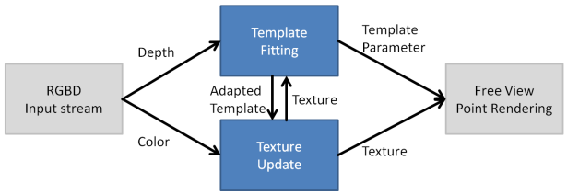
Scope of this Paper
Preliminaries
System Setup
Pre-Processing
System Overview
Fitting the Template Model
Articulated Template Model
Objective Function for Tracking and its Minimization
Template Fitting Results
Texture Extraction
Texture Processing
Discrete Optimization
Experimental Results + Conclusion

Slide 6
Scope of this Paper
Preliminaries
System Setup
Pre-Processing
System Overview
Fitting the Template Model
Articulated Template Model
Objective Function for Tracking and its Minimization
Template Fitting Results
Texture Extraction
Texture Processing
Discrete Optimization
Experimental Results + Conclusion

Slide 7
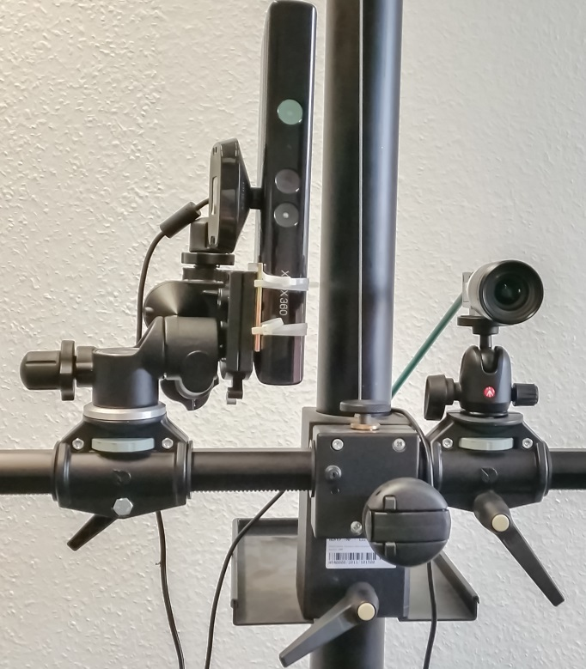
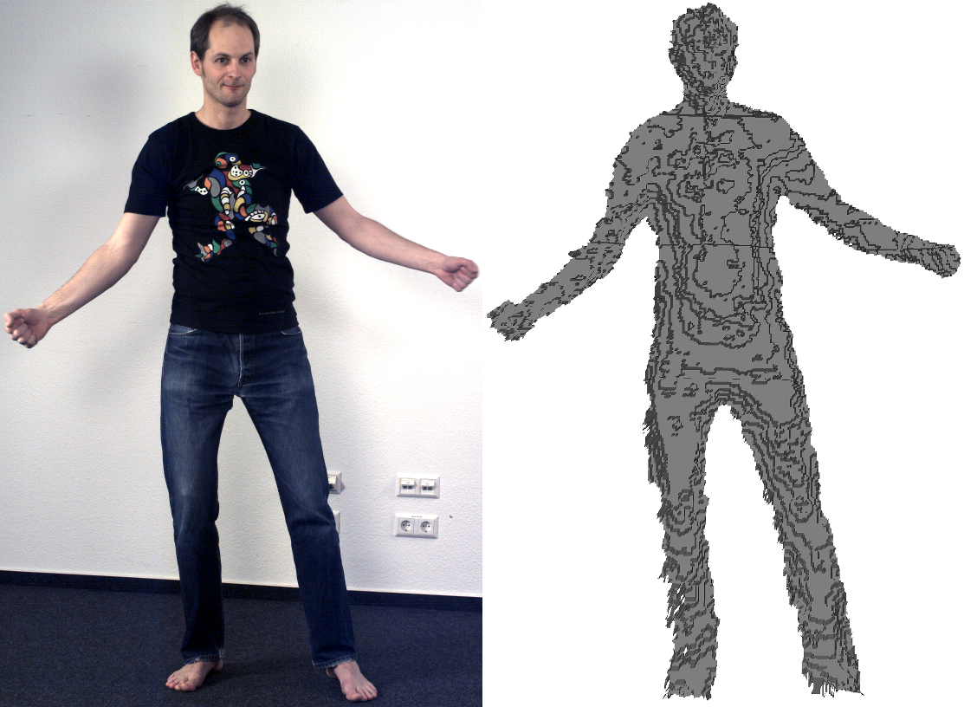
System Setup
1 x Microsoft Kinect (640x480 Depth @ 30 FPS)
1 x Basler acA2040-25gc (1600x2032 RGB @ 30 FPS)
with no
sync

Slide 8
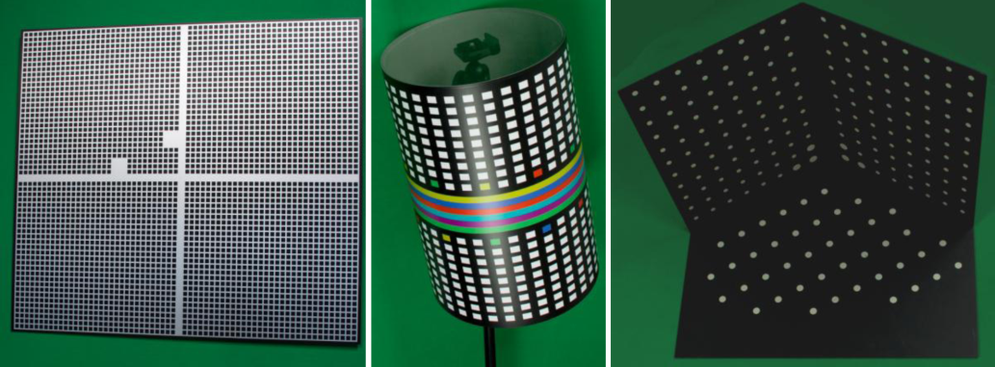
Pre-Processing
Calibration of internal/external parameters
Standard background subtraction on depth stream
Manual offline temporal alignment of RGB and depth
Depth map to 3D mesh conversion
Articulated template model of human including UV texture coordinates

Slide 9
System Overview
Usage of rigged 3D Computer Graphics model as template based on SCAPE [1,2] model
Adapt per frame the template to input mesh
Project adapted template into camera view
Update texture map
Template
Fitting
Template Parameter
Depth
RGBD
Input stream
Free View Point Rendering
Adapted
Template
Texture
Texture
Update
Color
Texture
[1] Aguelov et al., ACM Trans. on Graphics / SIGGRAPH, 2005.
[2] Fechteler et al., VMV, 2012

Slide 10
Scope of this Paper
Preliminaries
System Setup
Pre-Processing
System Overview
Fitting the Template Model
Articulated Template Model
Objective Function for Tracking and its Minimization
Template Fitting Results
Texture Extraction
Texture Processing
Discrete Optimization
Experimental Results + Conclusion

Slide 11
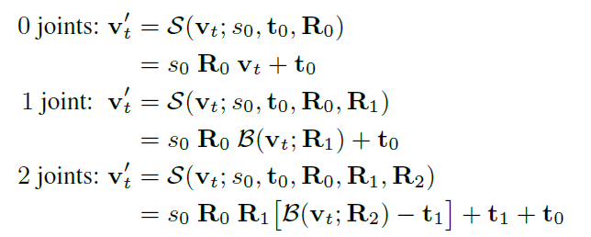
Articulated Template Model
Skinning equation based on kinematic chain
incl. blending function with twist/swing decomposition [3]
[3] Kavan et al., ACM SIGGRAPH Asia, 2012.

Slide 12
Objective Function for Tracking
Probabilistic approach inspired by Coherent Point Drift [4] algo
with probability-like weights
⇒ implicit inter-triangle matching
[4] Myronenko et al., PAMI, 2010.

Slide 13
Objective Function Minimized via EM algo
E-step: update based on given values for
M-step: update based on given values for
solve via Gauss-Newton algorithm: introduce ∆-perturbations
use approximation for small rotations
omit ∆-crossterms (=omission of higher order terms in Taylor approx.)
rearrange to and insert into
add Tikhonov regularizer for temporal consistancy
⇒ solve using standard least squares techniques

Slide 14
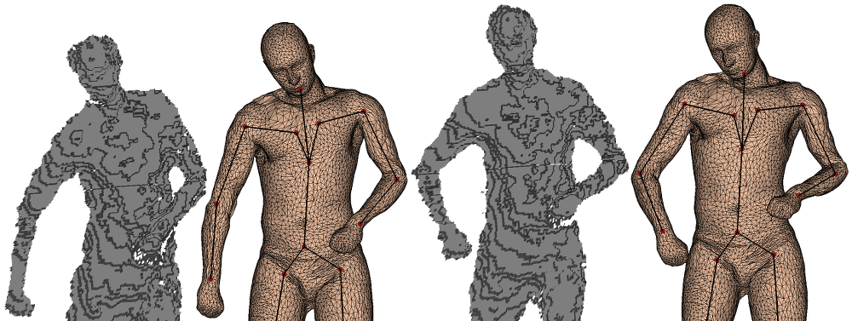
Fitting Results at Capture Rate 30 FPS
input
output
input
output
frame t
frame t+10

Slide 15
Scope of this Paper
Preliminaries
System Setup
Pre-Processing
System Overview
Fitting the Template Model
Articulated Template Model
Objective Function for Tracking and its Minimization
Template Fitting Results
Texture Extraction
Texture Processing
Discrete Optimization
Experimental Results + Conclusion

Slide 16
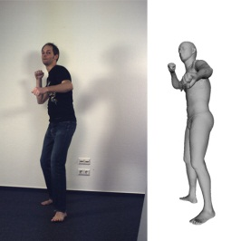
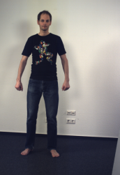
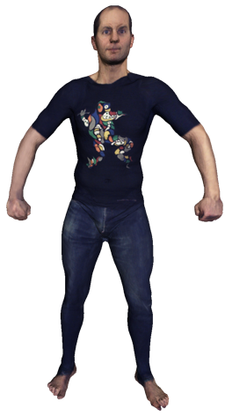
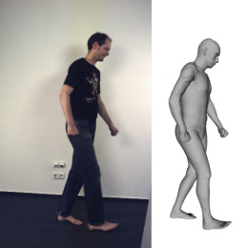
Texture Processing
Set of tracked meshes with captured color images
Discard old and redundant data
Select one source image for each triangle based on
Visual detail of the source image
Temporal distance / occluded parts from past
Visibility of seams

Slide 17
Texture Map Generation = Discrete Optimization
Objective function
with visual quality and temporal actuality term
and optimal seam
solved with Graph Cuts algorithm [5]
[5] Boykov, Kolmogorov, PAMI, 2004.

Slide 18
Scope of this Paper
Preliminaries
System Setup
Pre-Processing
System Overview
Fitting the Template Model
Articulated Template Model
Objective Function for Tracking and its Minimization
Template Fitting Results
Texture Extraction
Texture Processing
Discrete Optimization
Experimental Results + Conclusion

Slide 19
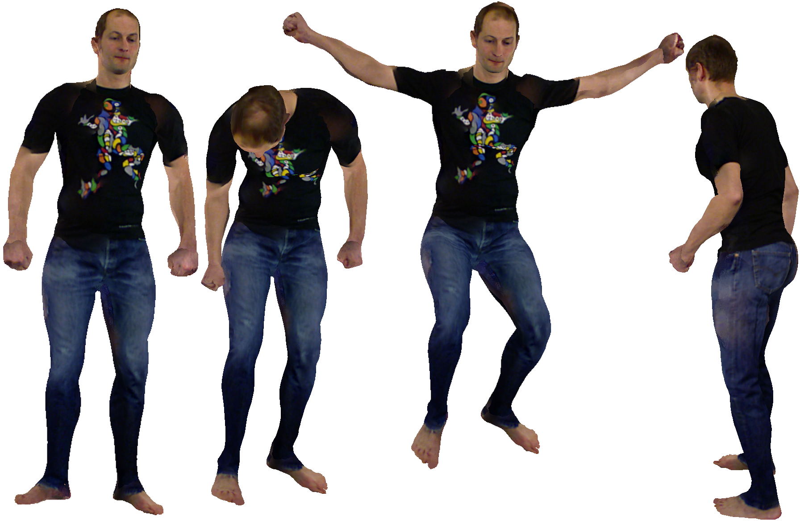
Experimental Results

Slide 20
Experimental Results

Slide 21
Experimental Results: Full Body

Slide 22
Experimental Results: Close-up + Dynamic Textures

Slide 23
Conclusion
We have presented an approach to ...
Capture humans from Kinect+Camera
Fit an articulated Computer Graphics model per depth frame
Extract corresponding texture region from RGB
Update consecutively the texture map without visible seams
Computer Graphics animation of resulting model

Slide 24
Thank you. Questions?

