Slide 1
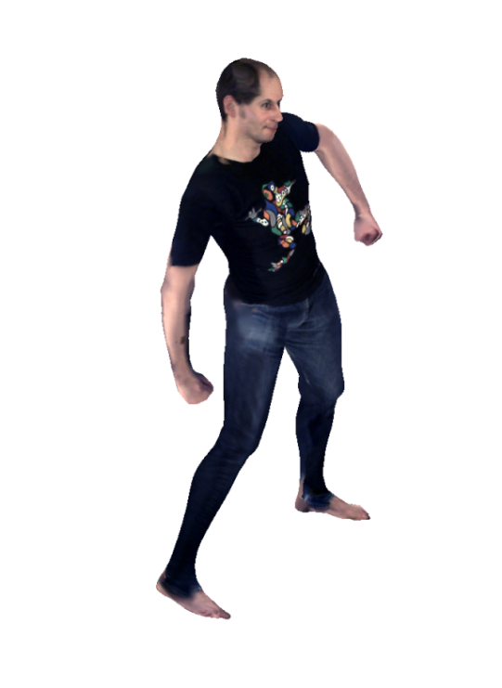
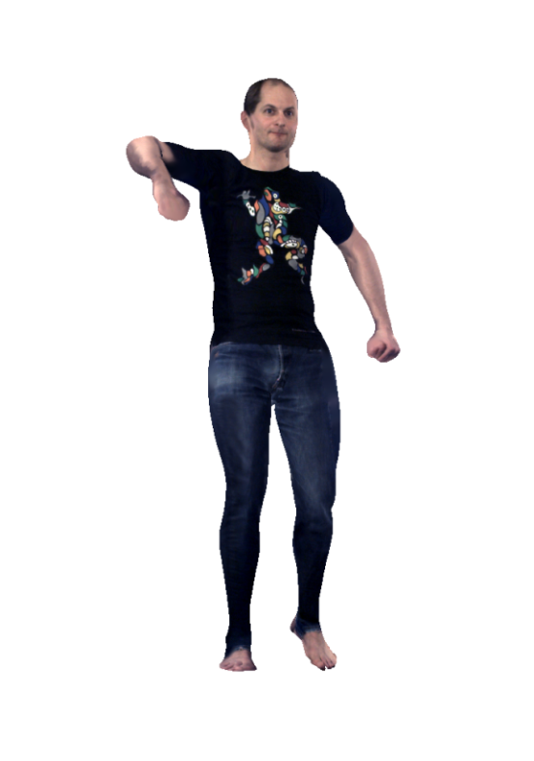
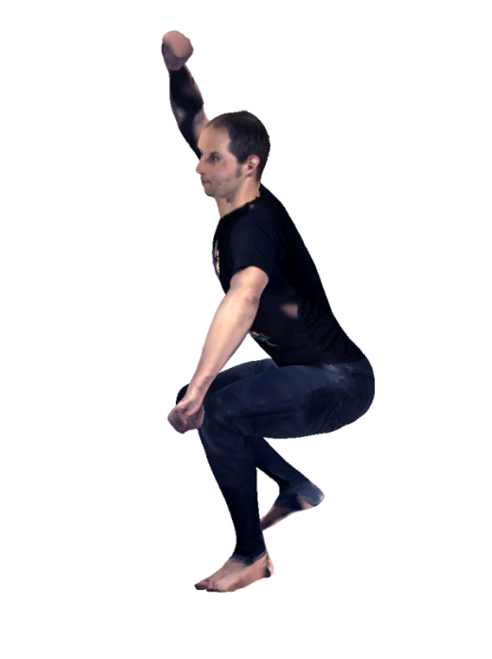
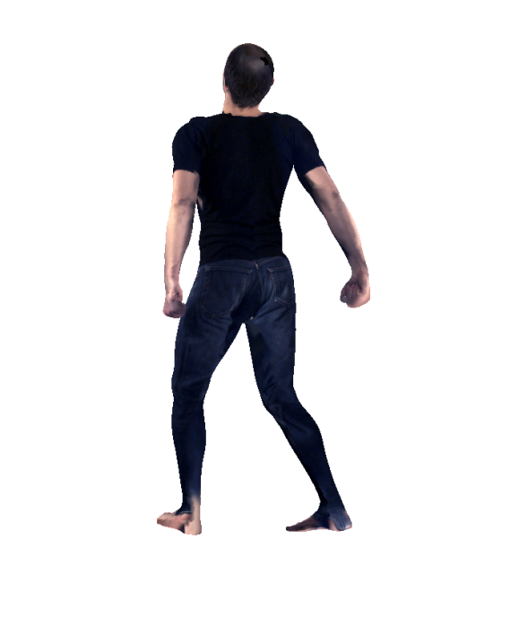
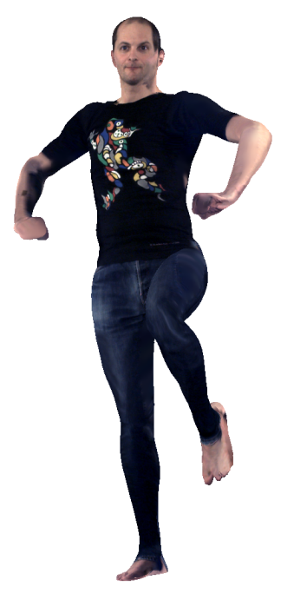
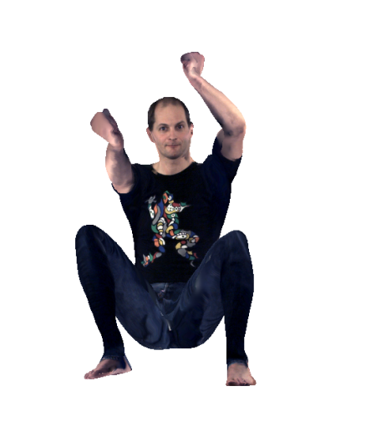
Real-Time Avatar Animation with dynamic Face Texturing
P. Fechteler, W. Paier, P. Eisert
IEEE ICIP 2016
26. September 2016

Slide 2
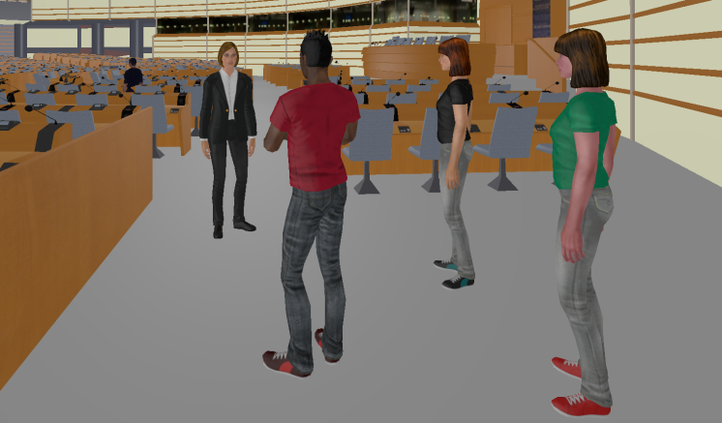
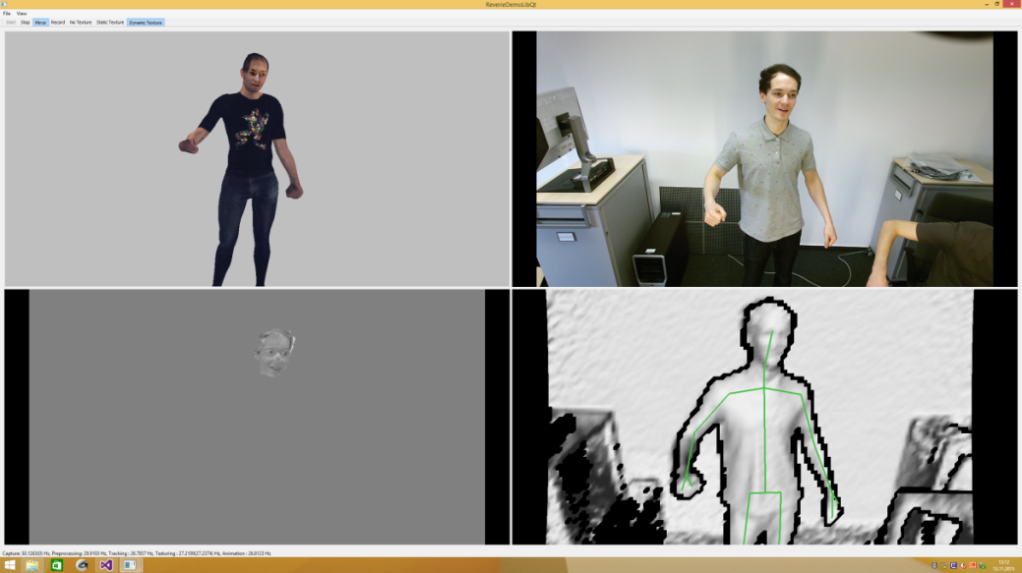
Motivation
Light-weight parametrization for photo-realistic 3D human representation
Ability to animate to allow autonomous behaviour of avatars
On-the-fly capturing and extraction of control parameters

Slide 3
Motivation
Capture & animation
Robust, realtime
No complex capture setup (1xRGBD stream)
Compact representation (transmission, animation)
Purely geometry based -> usually difficult (1 view, low resolution)
Dynamic face textures
No deformation tracking (difficult in low resolution)
Rigid motion tracking (global head pose adjustment)
Lightweight and realistic alternative
Full body template model
Robust
Plausible geometry (even in occluded areas)
Compact representation (skel. animation)

Slide 4
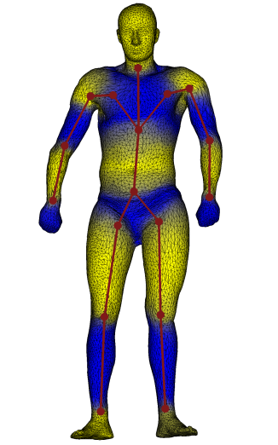
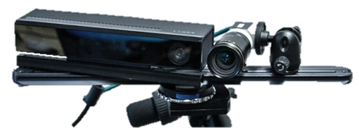
Our approach
Combination of Image-Based Rendering and Computer Grahphics techniques
captured video texture
geometric shape model
animiated result

Slide 5
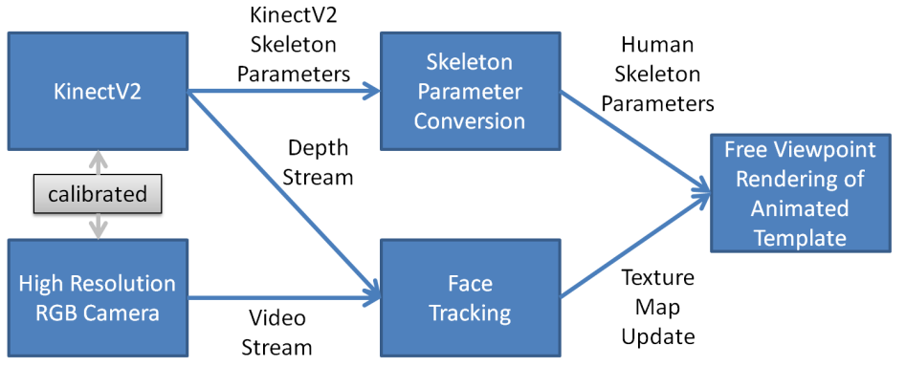
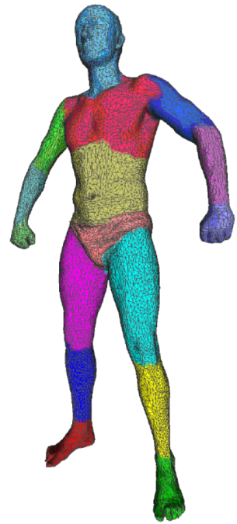
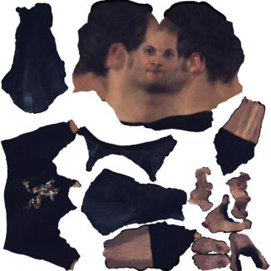
Scope of this Paper
Preliminaries
System Setup
Pre-Processing
System Overview
Articulated Geometry
Articulated Template Model
Objective Function for Tracking and its Minimization
Template Fitting Results
Realtime Dynamic Texturing
Face Tracking
Dynamic Textures
Experimental Results + Conclusion

Slide 6
Scope of this Paper
Preliminaries
System Setup
Pre-Processing
System Overview
Articulated Geometry
Articulated Template Model
Objective Function for Tracking and its Minimization
Template Fitting Results
Realtime Dynamic Texturing
Face Tracking
Dynamic Textures
Experimental Results + Conclusion

Slide 7
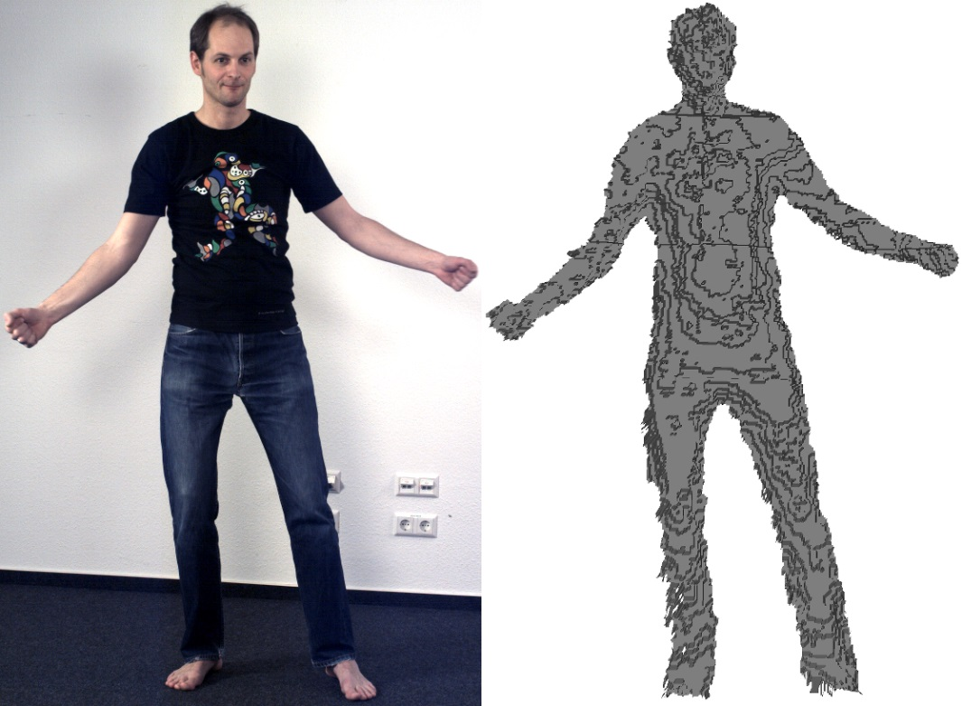
System Setup
1 x Microsoft Kinectv2 (512x424 Depth @ 30 FPS)
1 x Basler acA2040-25gc (1600x2032 RGB @ 30 FPS)
SW
Sync

Slide 8
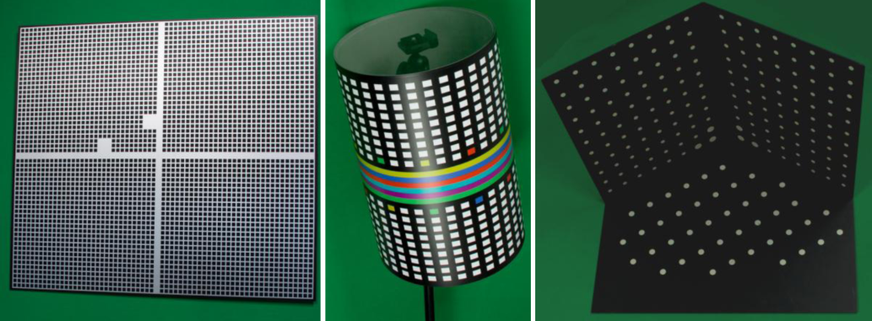
Pre-Processing
Calibration of internal/external parameters
Standard background subtraction on depth stream
Manual offline temporal alignment of RGB and depth
Depth map to 3D mesh conversion
Articulated template model of human including UV texture coordinates

Slide 9
System Overview
Usage of rigged 3D Computer Graphics model as template based on SCAPE [1,2] model
Adapt per frame the template to input mesh
Rigid Face Tracking
Update texture map
Template
Fitting
Template Parameter
Depth
RGBD
Input stream
Face
Tracking
Free View Point Rendering
Rigid Head Pose
RGBD
Texture
Update
Dynamic Texture
RGB
[1] Aguelov et al., ACM Trans. on Graphics / SIGGRAPH, 2005.
[2] Fechteler et al., VMV, 2012

Slide 10
Scope of this Paper
Preliminaries
System Setup
Pre-Processing
System Overview
Articulated Geometry
Articulated Template Model
Objective Function for Tracking and its Minimization
Template Fitting Results
Realtime Dynamic Texturing
Face Tracking
Dynamic Textures
Experimental Results + Conclusion

Slide 11
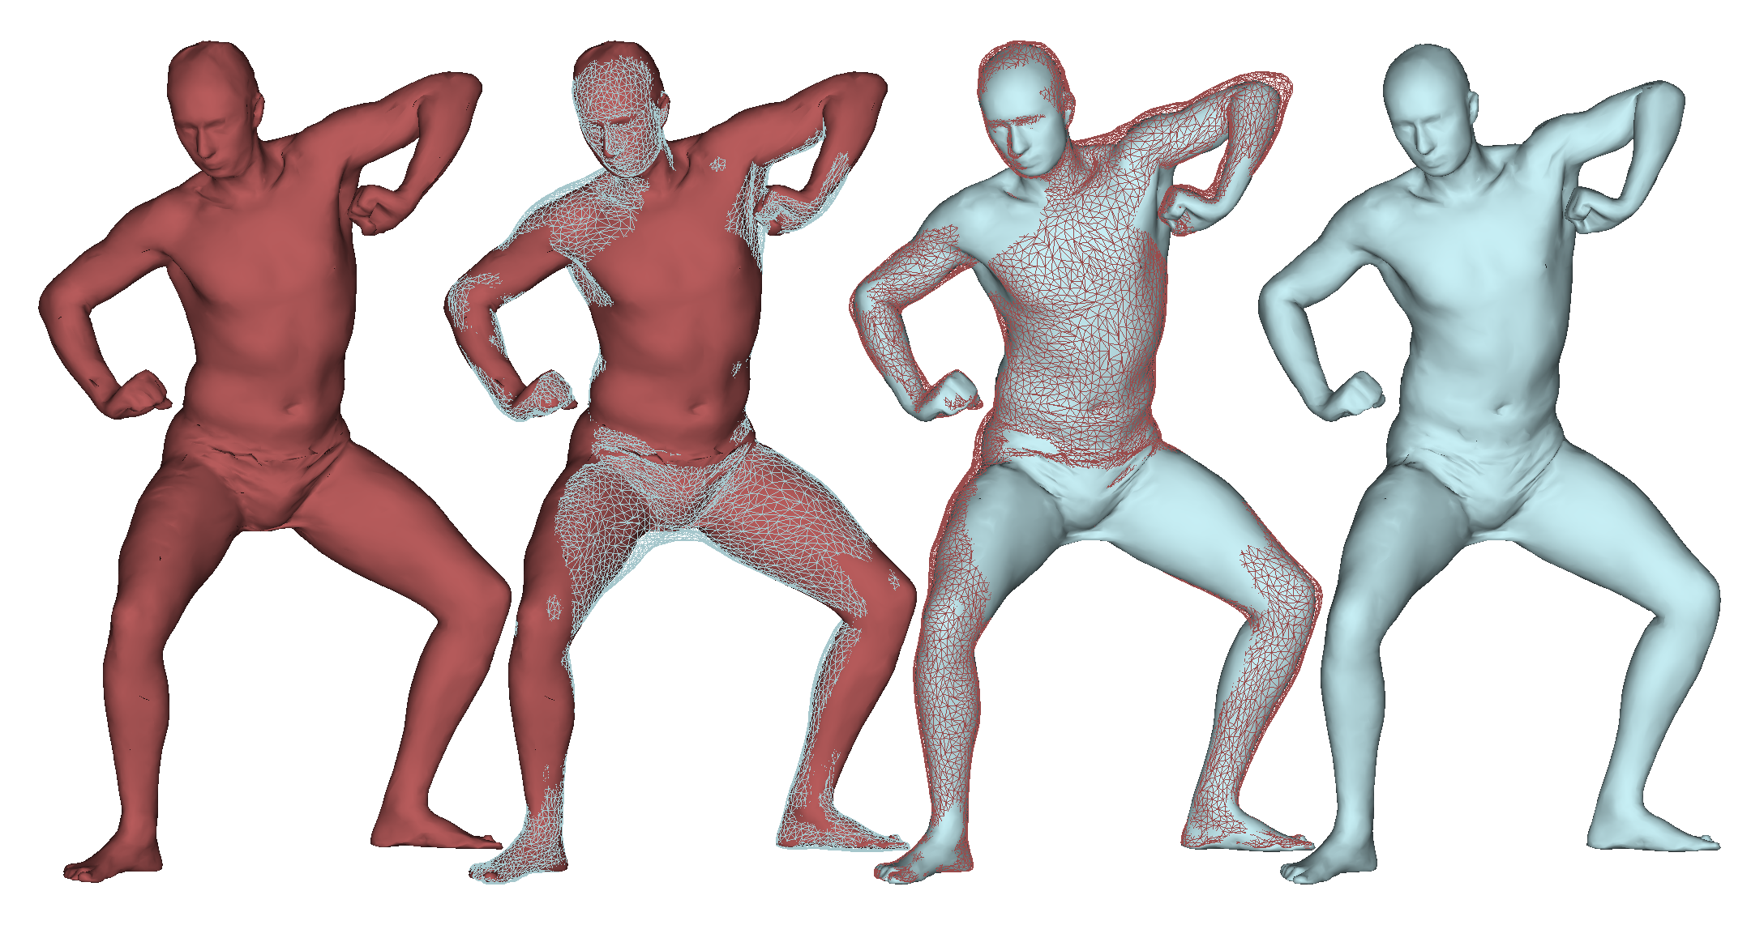
Naturalistic animation of articulated geometry
Dual quaternion Linear Blending (DLB) ⇒ blending of more than two joints, e.g. shoulder, pelvis
combination of DQS for twist and LBS for swing motions ⇒ to get rid of artifacts, e.g. candy-wrapper/LBS and bulging/DQS
Fechteler et al., Example-based Body Model Optimization and Skinning, EUROGRAPHICS, 2016.
Captured
3D Scan
Animated Model

Slide 12
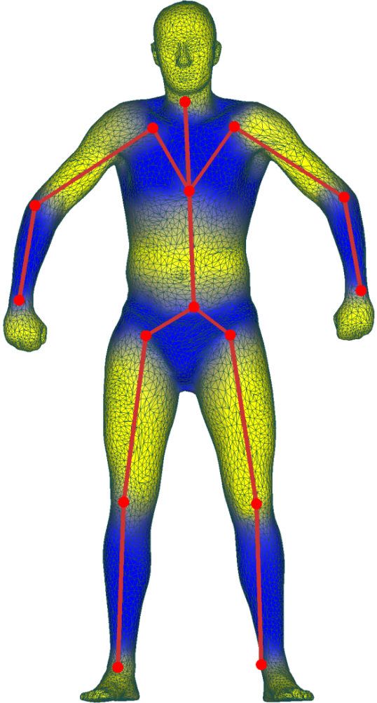
Requirement: conversion of skeletal parameters
positional vs. angualar encoding
different joint positions
different topology
Kinect
DLB Model

Slide 13
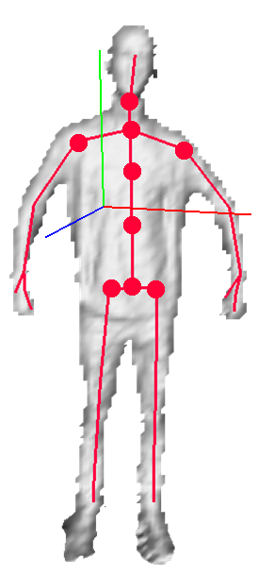
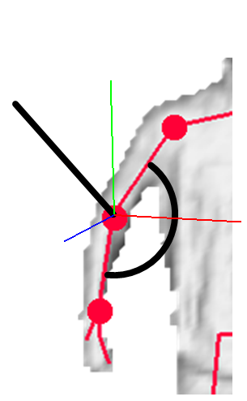
Conversion of skeletal parameters
Rotation of head given from face tracking
Global, breast and waist rotations via PCA of torso joints etc
Remaining joint rotations via vector- and scalar product of successor/predecessor joints

Slide 14
Scope of this Paper
Preliminaries
System Setup
Pre-Processing
System Overview
Articulated Geometry
Articulated Template Model
Objective Function for Tracking and its Minimization
Template Fitting Results
Realtime Tracking & Texturing
Face Tracking
Dynamic Textures
Experimental Results + Conclusion

Slide 15
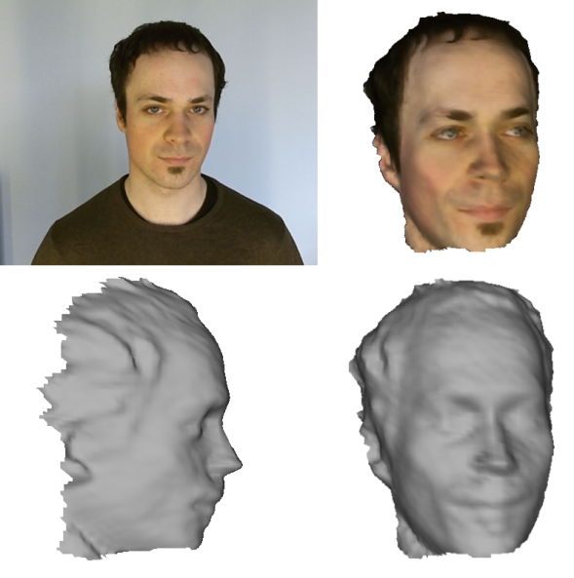
Realtime Face Tracking
Automatic Tracking Model Generation
During initialization phase
Subject rotates head left/right
Approx. 180° 3D scan + texture
Face Tracking
Analysis by synthesis approach
Find rigid head motion
Minimize color & geometry mismatch
Example of a tracking model
translation vector (tx,ty,tz)
scalar weighting
euler angles (rx,ry,rz)

Slide 16
Realtime Face Tracking
Color Mismatch
Squared intensity difference
Geometry Mismatch
Point to plane error metric
Projective correspondence search
captured image
synthetic image based on current parameter estimate
corr. surface-normal in target geometry
Transformed model vertex
corr. 3D point in target geometry

Slide 17
Dynamic Texturing
Facial expression is captured in texture space and updated in every tracked frame
Parallel implementation
Texture extraction
Project image on mesh/texture space
Fill unseen regions with tracking texture
Texture blending
Poisson image editing

Slide 18
Experimental Results

Slide 19
Experimental Results

Slide 20
Experimental Results

Slide 21
Experimental Results

Slide 22
Conclusion
We have presented an approach to ...
Capture humans from Kinect+Camera
Fit an articulated Computer Graphics model per depth frame
Extract corresponding texture region from RGB
Update consecutively the texture map without visible seams
Computer Graphics animation of resulting model

Slide 23
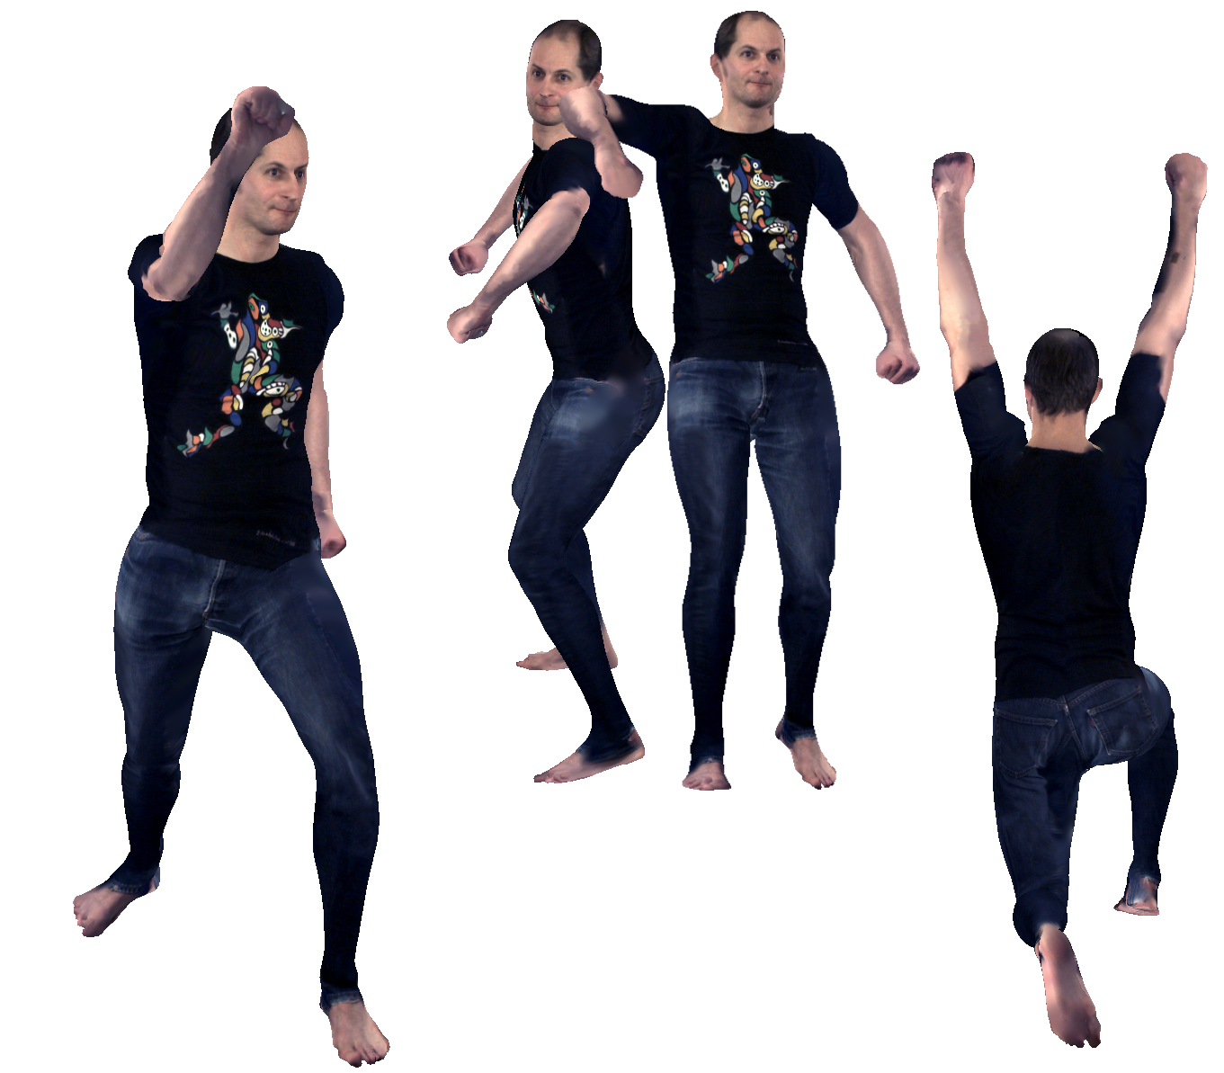
Thank you. Questions?

